Slide 1
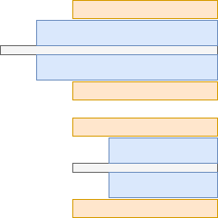
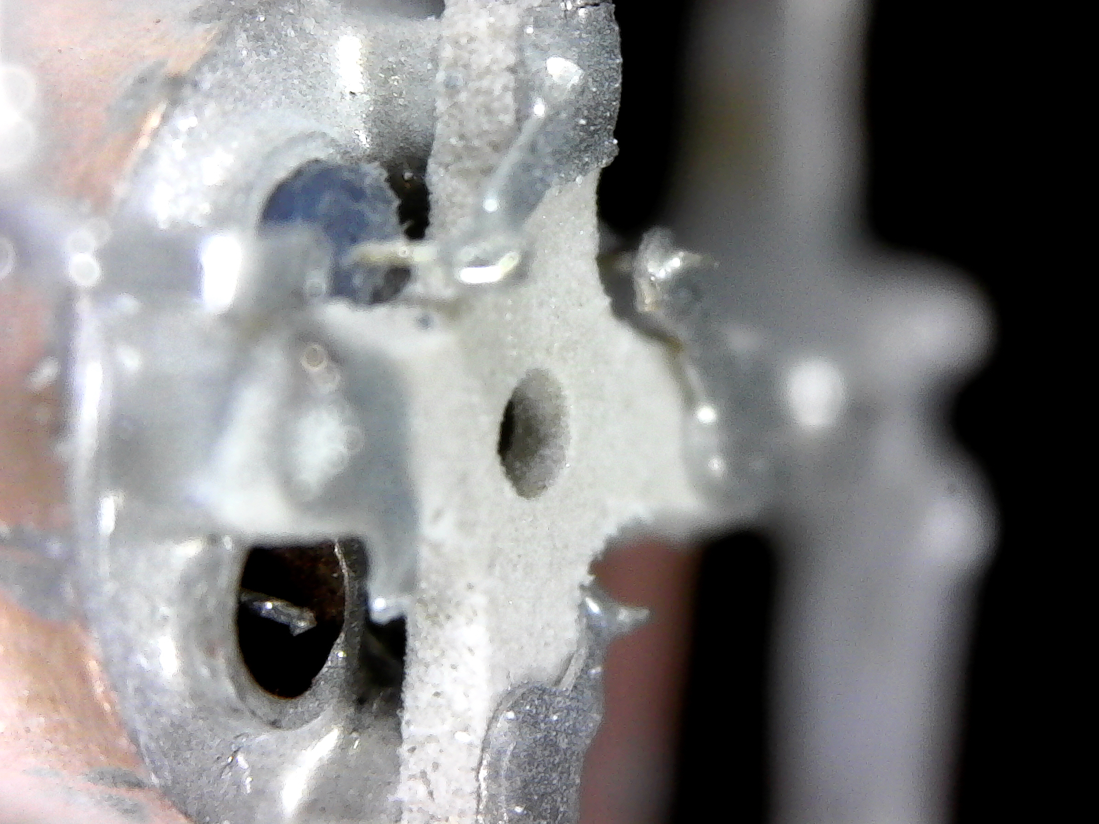
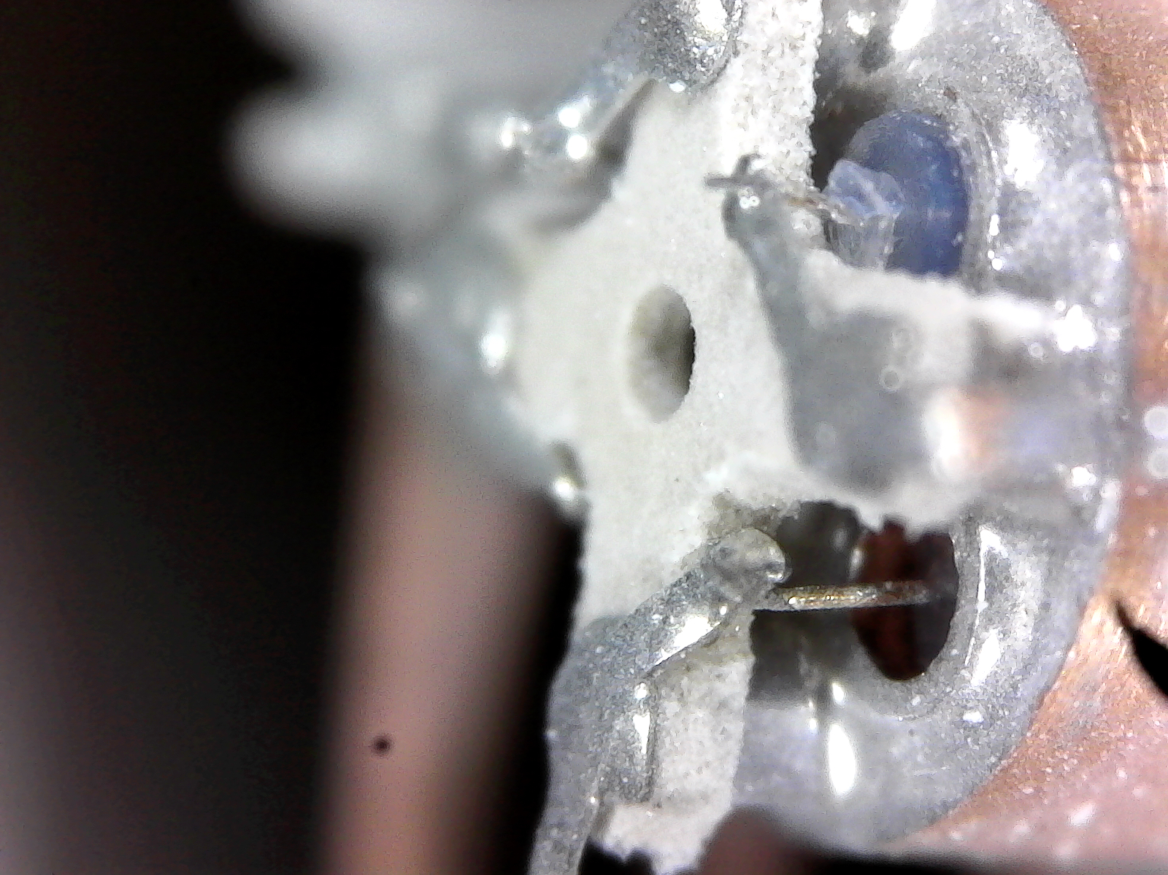
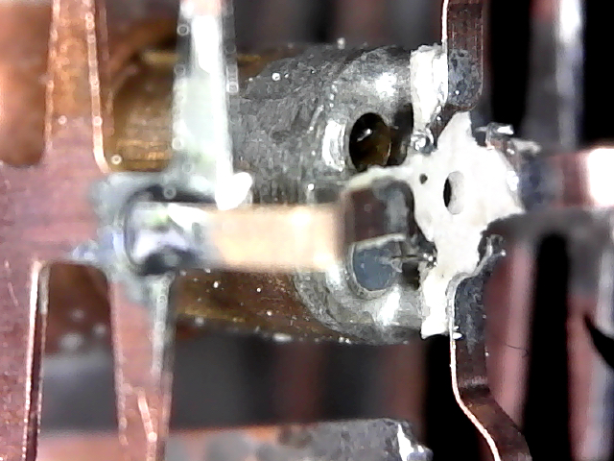
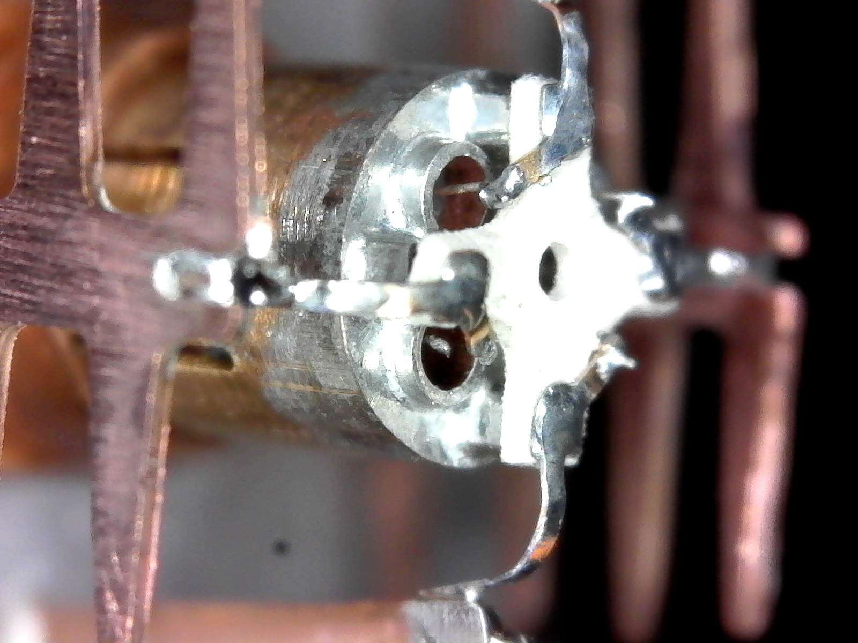
In all these cases the center conductor seems to be moving with the PTFE.
This indicates that there is a good mechanical connection / friction between the center core and the PTFE.

Slide 2
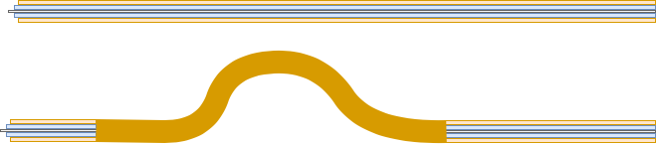
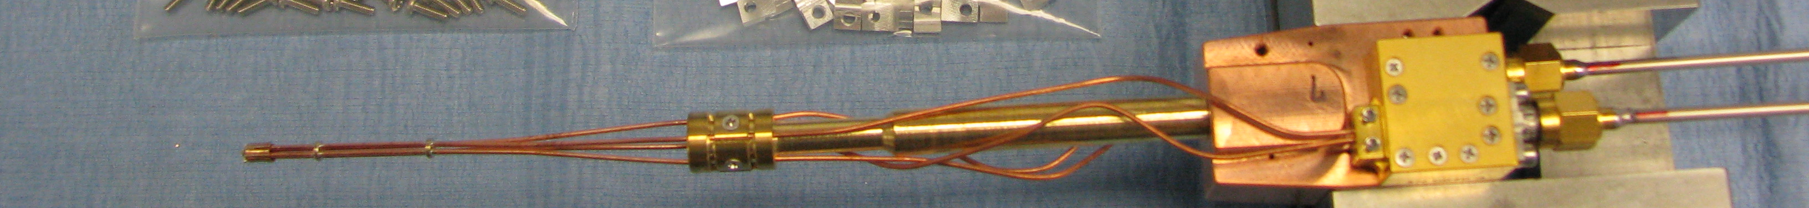
Having a long straight section will allow the PTFE and center conductor to move freely within the outer conductor.
By introducing a bend as close to the top as possible we might be able to accommodate the thermal expansion and could reduce the retraction of the PTFE and center conductor.
This would also explain why the displacement is not visible at the LNA side (reduced), where we have bends fairly close to the LNA.
Remove second point where the four coaxial cables are connected (*)
Movement through thermal expansion
remove

